Slide 1
STOP! You’re automating too much! (and other tales from the field)
Shawn Wallace
Senior Architect, Centric Consulting
Session: E3

Slide 2
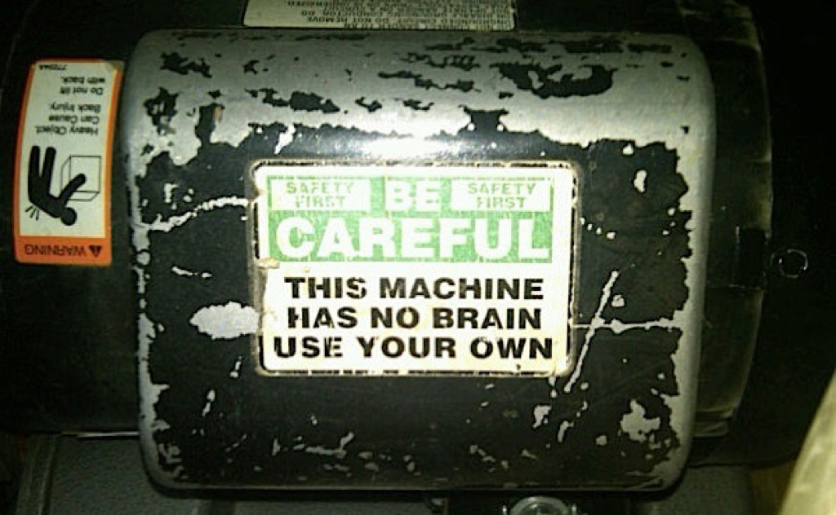

Slide 3
Why is test automation a good idea?

Slide 4
Our existences are about precise communication...and communication is about feedback loops

Slide 5
Our existences are about precise communication...and communication is about feedback loops

Slide 6
Why Acceptance Test Automation
Implementing changes more efficiently
Shortened feedback loop
Higher product quality
Less rework
Better work alignment to priority
Makes systems easier to change

Slide 7
Why Acceptance Test Automation
Implementing changes more efficiently
Shortened feedback loop
Higher product quality
Less rework
Better work alignment to priority
Makes systems easier to change

Slide 8
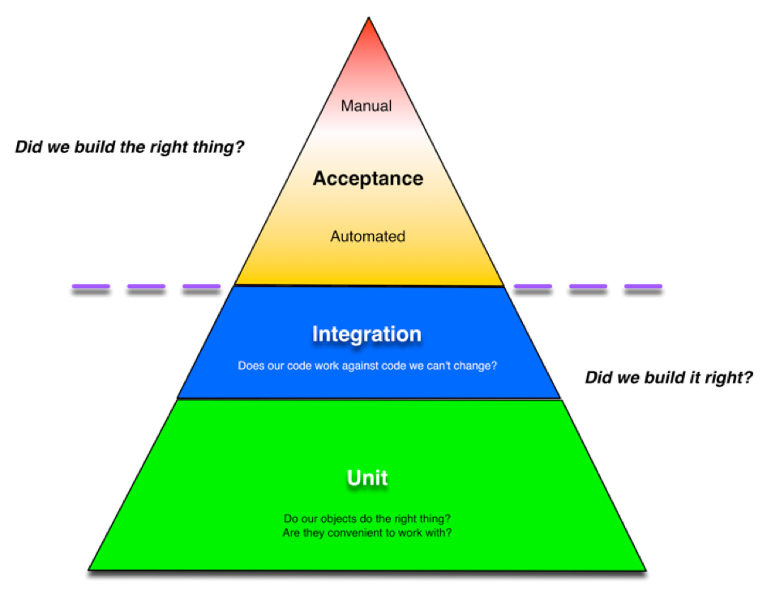

Slide 9
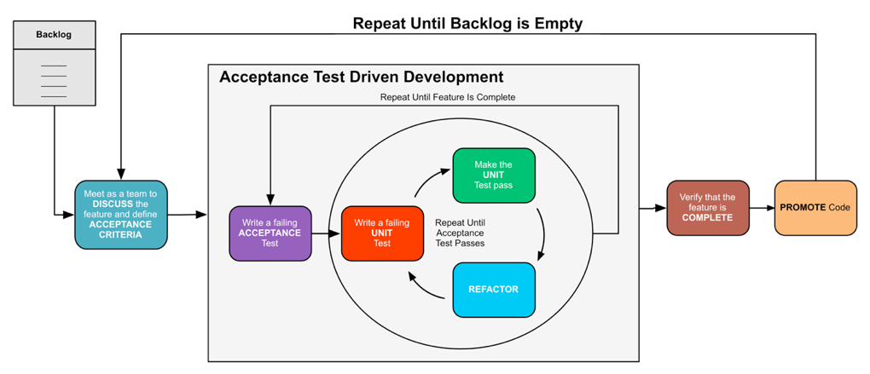
Part of the process…

Slide 10
Can my team benefit?

Slide 11
Can my team benefit?
We can improve design going forward
If we remember
The goal is writing working code/providing value

Slide 12
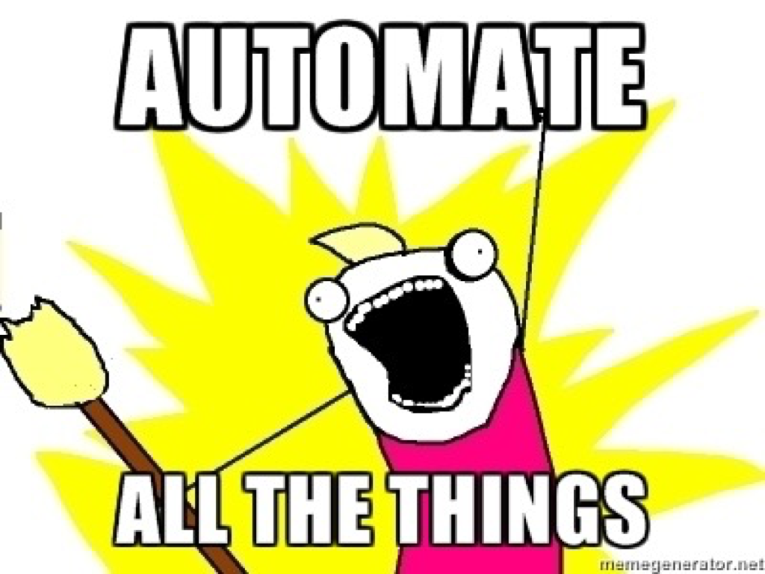

Slide 13
How do I get started?

Slide 14
How do I get started?
Test KEY use cases
Test defects
Test new features

Slide 15
What should I automate?

Slide 16
What should I automate?
You are testing the behavior of your system
What do you need to test to determine if your system is behaving?
Regression is a side-effect

Slide 17
Don’t forget your testing triangle

Slide 18
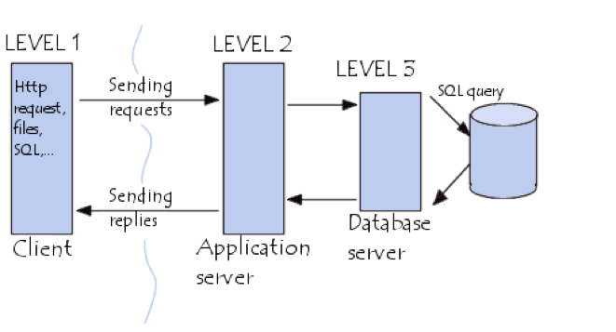
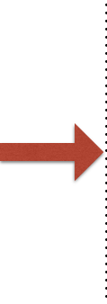
What should I automate?
Deliberately test your system at the physical boundaries.
Know what your system does and how it works
Collaborate! Collaborate! Collaborate!

Slide 19
Where does automation fit in with our process?

Slide 20
Where does automation fit in with our process?
We define our Aceptance Criteria
AND
Encode them as Acceptance Tests

Slide 21
What solution and architectural dependencies am I driving?

Slide 22

What technical changes am I driving?
Poorly designed or implemented systems tend to be hard to test
Code under test might need to be refactored
Test suite could be inefficient

Slide 23
Case study in pain
Huge Automated Functional Test
5500+ Scenarios
550+ Hours to Execute

Slide 24

Automated Functional Test Running Infrastructure
Notes:
This is our test running environment needed to get the test run down to 12 hours.

Slide 25
Case study in pain
1 Team
1.5 Years
$1,000,000

Slide 26
Test code IS code

Slide 27
Testing takes time and resources and requires a skill-set you might not have yet.

Slide 28
How will I run my tests?

Slide 29






Slide 30
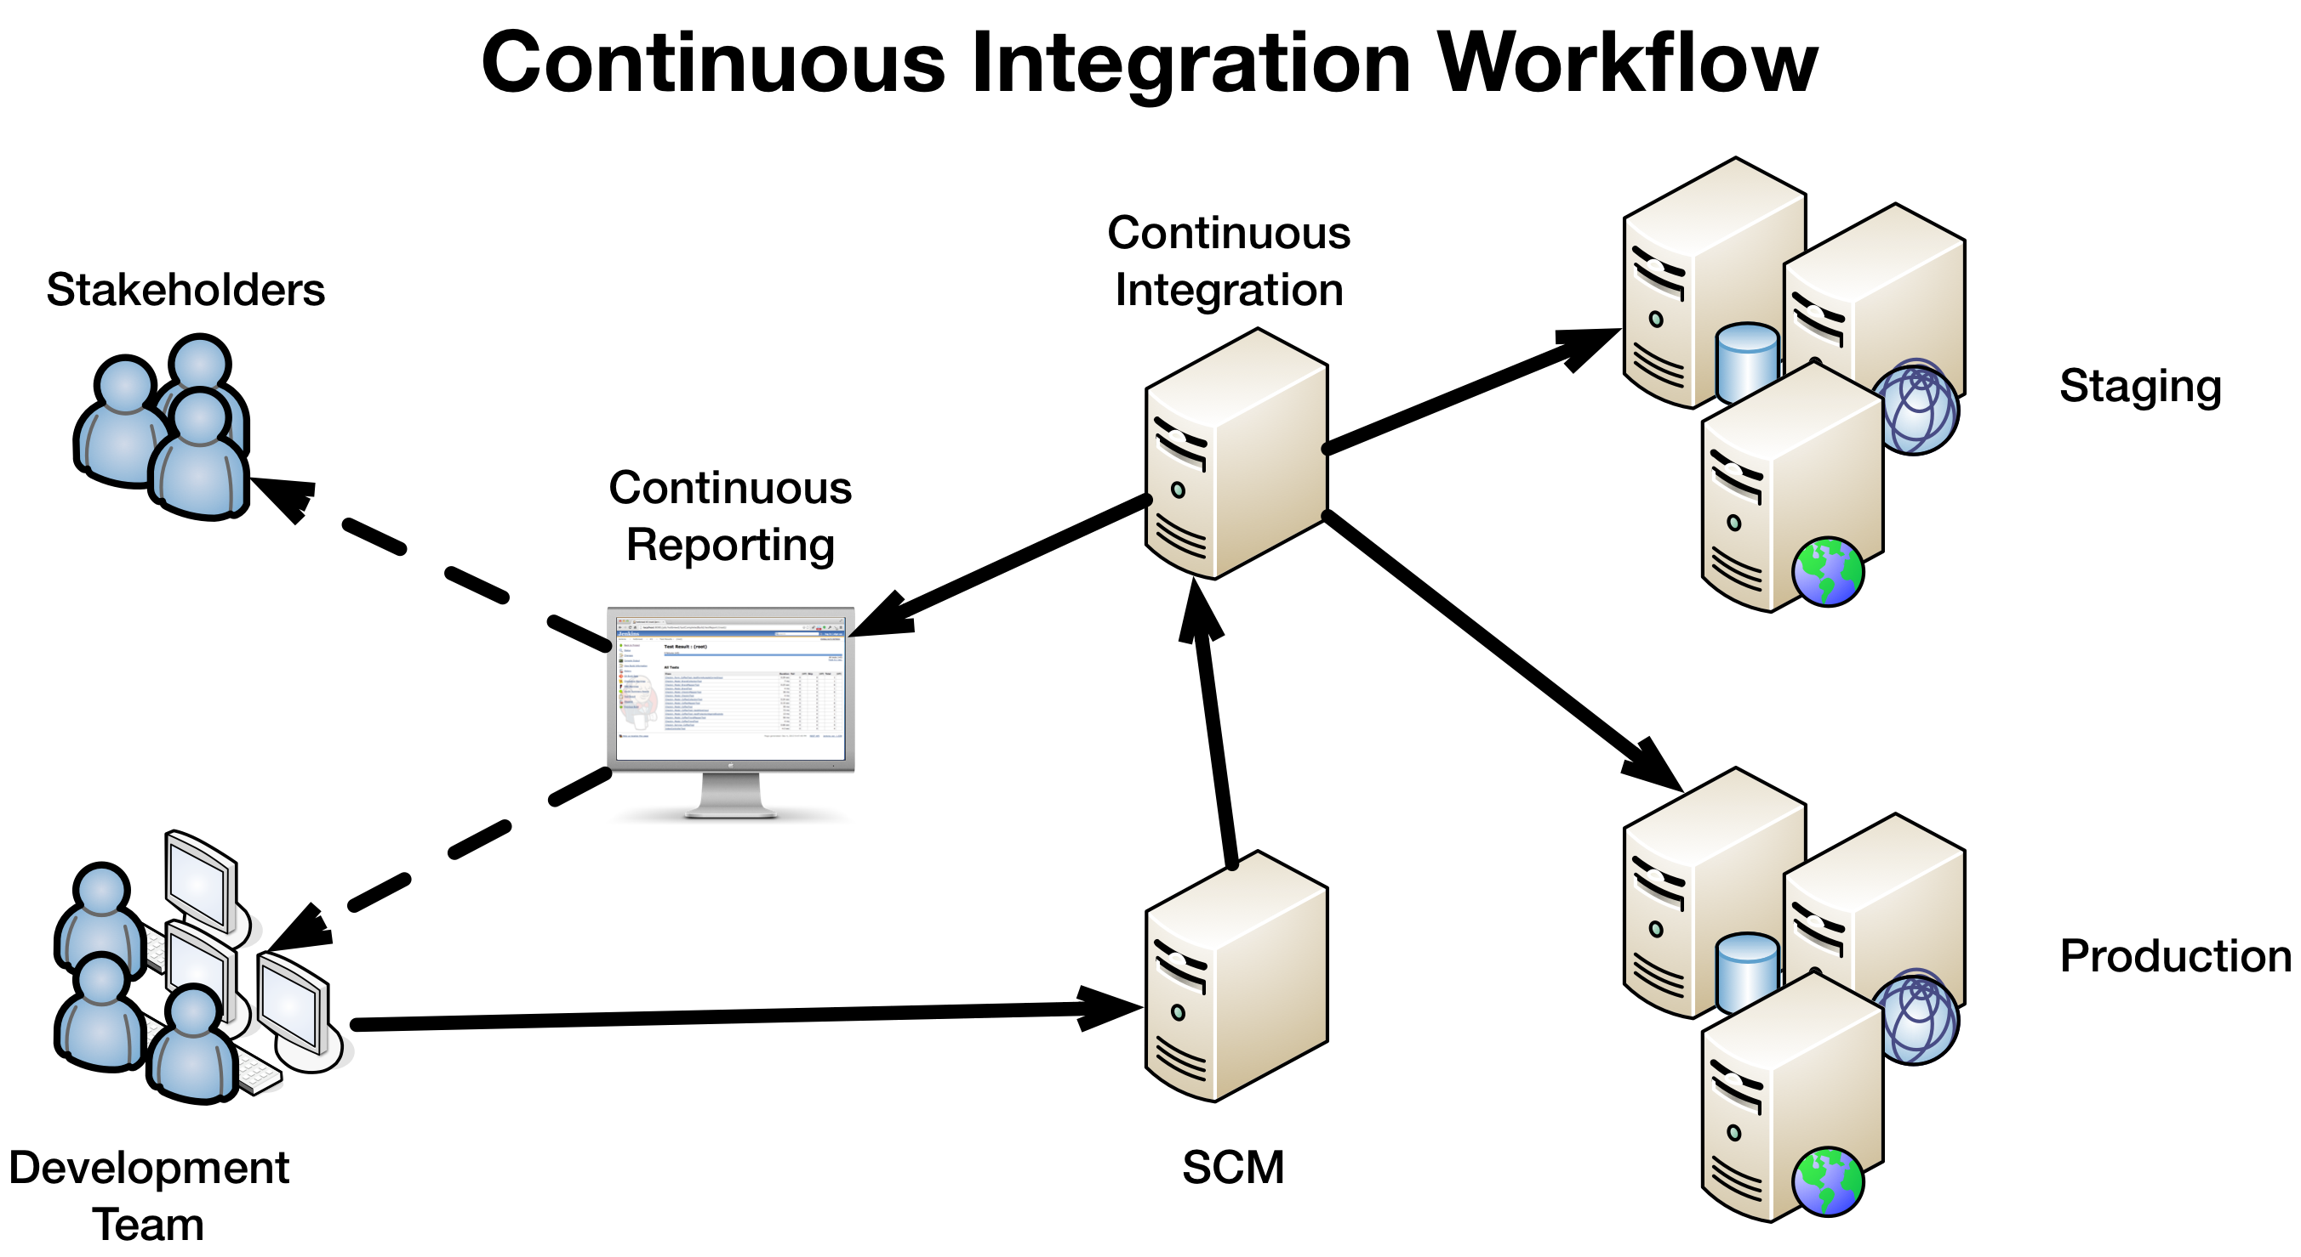

Slide 31
What do I do with all of the data?
Test automation generates a large volume of data…not all valuable
Need a way to store, filter, and make visible

Slide 32
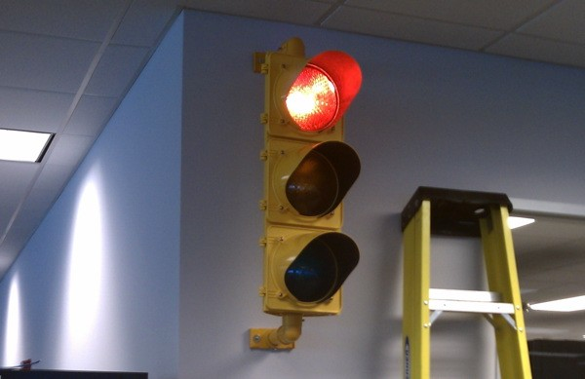
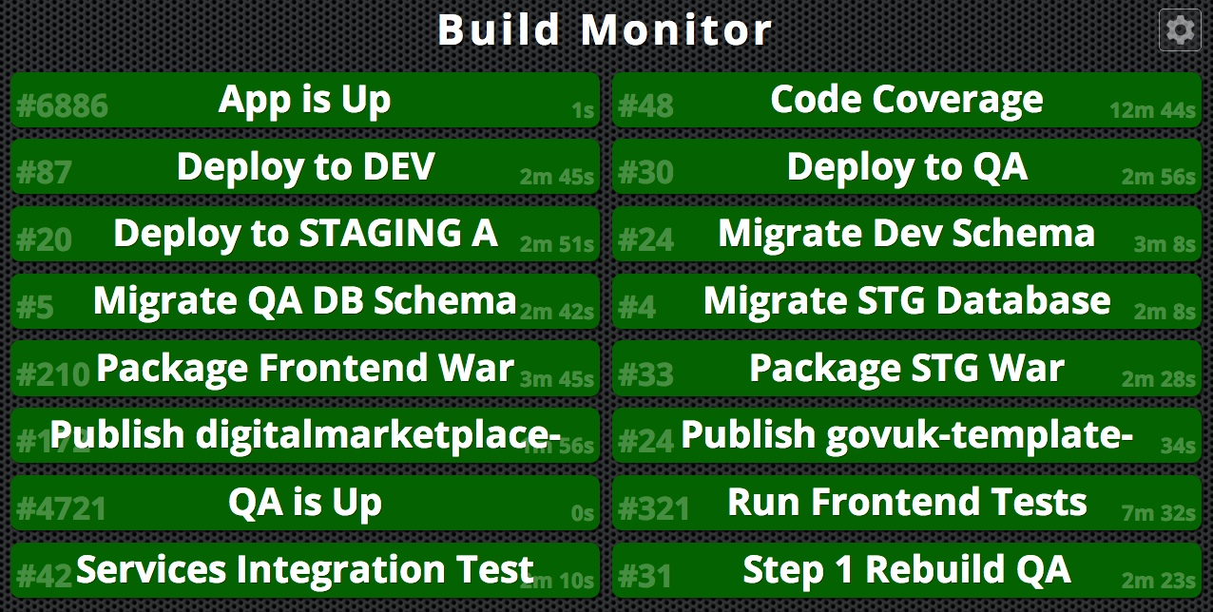
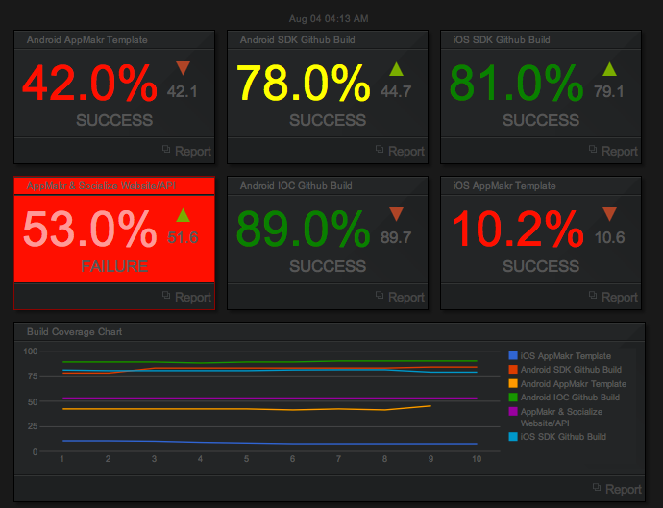
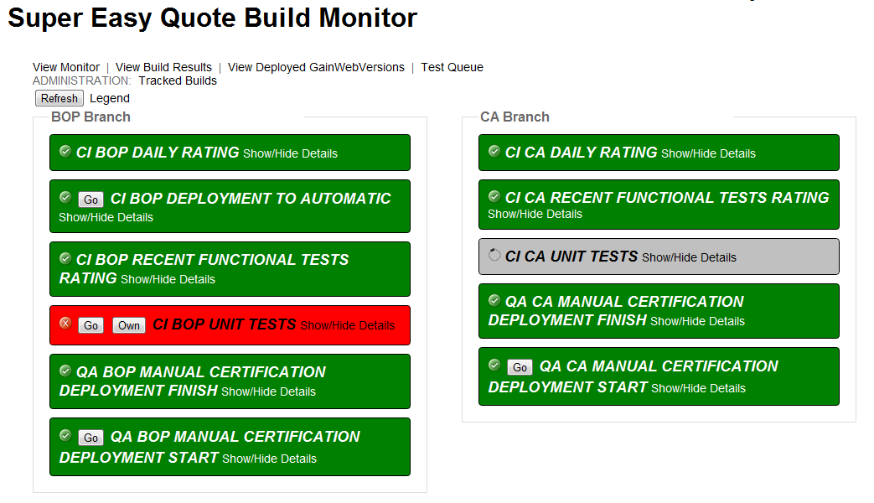

Slide 33
Do I always need to run all of my tests?

Slide 34
Run subset of all automation
DEVELOPMENT
Merge
Run entire suite
MAINLINE
Merge
PRODUCTION
Run smoke tests

Slide 35
Do I need to keep my tests forever?

Slide 36

According to ATDD you do…
Notes:
BDD is how we encode the failing ACCEPTANCE test

Slide 37
Practically, some tests are better for development than for regression

Slide 38
How will I know if I’m doing a good job?

Slide 39
How will I know if I’m doing a good job?
Understand your goals
Define what success means in your environment.

Slide 40

Notes:
beware of overconfidence in your test suite

Slide 41

That’s all…

Slide 42
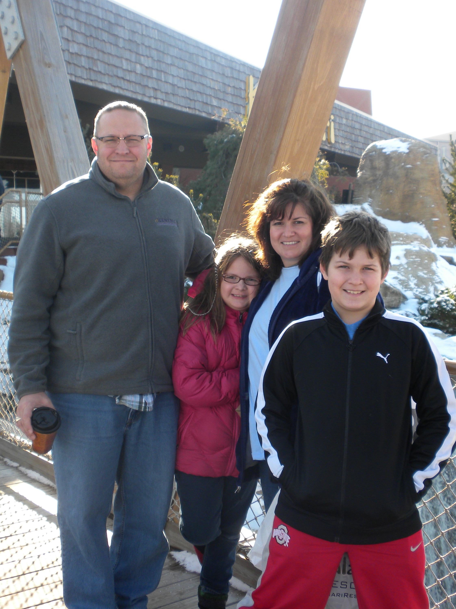

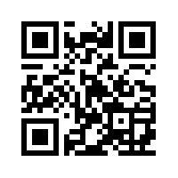
Shawn Wallace
Work: shawn.wallace@centricconsulting.com
Twitter: @ShawnWallace
Blog: www.shawnewallace.com
http://www.about.me/shawnwallace

Slide 43
Q&A
For more information...
This Presentation on GitHub
https://github.com/shawnewallace/testing_too_much_presentation
cukes.info
Gojko Adzic
cuke4ninja.com
Specification by Example
https://github.com/aslakhellesoy/cucumber/wiki
http://groups.google.com/group/cukes
http://www.cheezyworld.com
The Cucumber Book, Matt Wayne, Aslak Hellesøy: http://pragprog.com/book/hwcuc/the-cucumber-book
The Rspec Book, David Chelimsky: http://www.pragprog.com/titles/achbd/the-rspec-book

